Slide 1
Bongo
… buy and sell used items easily

Slide 2

Introduction
Bongo represents a smart and trendy thrift shopping experience where customers make intelligent lifestyle choices while saving money. It embraces the spirit of curated, stylish used items easily and effortlessly.

Slide 3
Case for Business
Being a parent in Nigeria, where food inflation exceeds 31% (NBS, 2024), Clothes, Electronics and Transport rising by 500%, We looked for first-grade thrift furniture, sofas, fittings—typically unworn with tags—as a cheaper lifestyle alternative as a parent.
Seeing an opportunity in the market, We plan to redefine lifestyle affordability through e-commerce and logistics. As Nigeria's thrift market is valued at $2.5 billion (Statista, 2023), We will provide curated high-end thrift selections for all items, allowing customers to save up to 50% on decent quality items and Home options. We aim to turn thrift shopping into a smart and orderly experience.

Slide 4
The Problems
Rising Cost of Living
Disorganized Alternatives
No Defined Market Place
500% inflation on foreign garments & Gadgets.
31% inflation of food
extensive supply chains incrementing costs by 40%.
57% of Quality is eroded on arrival
High Disorganized Pricing
Market inconvenience and Insecurity.
High cost of warehousing
Market is highly informal
Stressful and risky at entry & at exit.
Discourages lifestyle, Home Options and brand preference.

Slide 5
The Opportunities
Bongo revolutionizes Africa's thrift Options & market with Systematic curated second-hand Items at 50% discount. The platform reduces supply chain waste, cuts inefficiencies, and retail markups, offering affordable items, capitalizing on Nigeria's growing e-commerce market and Africa's $40 billion thrift industry.

Slide 6
Solutions
Systematic Curation
E-Commerce Experience
Personalized Recommendations
Items are verified with sellers.
Listing & Personalization
AI-driven recommendations
Customer Preference & Filter.
User Friendly Experience & Easy browsing.
Multiple selection & Fast Checkout
Order tracking and monitoring.
Reliable and Secure Payment Gateway & Settlement.
Escrow Payment & Payment gateway
Quality Pre-loved Items & brands.
20%-50% price variance on traditional retail prices.
Lifestyle brand & Styles are preserved.
Prompt Order fulfillment & Delivery.

Slide 7
The Market opportunity
Target Market in Year 1
Target Customers
Africa's Thrift Market is valued at $40 billion, with a 7.33% CAGR, providing an incredible opportunity for growth.
E-commerce Growth in Nigeria is projected to reach $6.4 billion by 2025 (Statista).
$40Billion
Market Size ready for Disruption in Africa
Tech Savvy Price Conscious Consumers in: - Lagos Metropolis.
Students
Young professionals
Young Families
Corporate bodies

Slide 8
Factors Driving Growth
Growing Demand for used items: A rising consciousness for eco-friendly alternatives is driving demand for used options.
Bongo’s unique value proposition targets the middle-income population seeking affordable used without sacrificing quality.
2025
70% Younger Population & Families
Market Size
65%
80%
40%
54.3% individuals & Corporates make disposals
Yearly
Delivery Value as at 2024
$6.4B
Mobile Revolution in Nigeria
80% of Urban Settlers buy second hand items.
Access to Internet in Nigeria
Market Size

Slide 9
Buyers’ User Journey
Sign Up on Web App
Update Personal Profile
Enter Phone No.
Generate unique IDs
Ai product rotation display
Product Features
Price details are displayed
Availability checked
Login to App
Move to checkout
Enter drop-off address
Generate OTP & Track
Registration
Browse Items & use Filters
Order Placed & Payment Made
IF SATISFIED
Payment notification
Auto receipt
Auto report
Rating of seller
Platform fee is charged
Cost includes bank Fees
Seller gets payment
Bongo gets cut
Customers organizes Logistics
Customer verifies Item authenticity
Communicates satisfaction
Transaction is completed
Payment is settled Using Auto Split
Payment Held in Escrow
DISPUTE RAISED
SELLER WINS
BUYER WINS
Seller gets paid
Platform Fees applies
Delivery Logistics fees applies
Bank Fees Applies
Buyer gets refunds
Platform Fees applies
Reverse Logistics fees applies
Bank Fees Applies
No action on payment yet
Dispute is reviewed with order list
Customer tags dispute area
Payment Held in Escrow
Seller Gets Paid
Refund is made to Buyer

Slide 10
Sellers’ User Journey
Sign Up on Web App
Update Personal Profile
Enter Email address
Generate unique IDs
Enable Ai product rotation display
Load Product Features
Price details are displayed
Set Availability timeline
Gets Order Notification
Login to Dashboard
Confirm Availability
Organize Logistics
Registration
Order Placed & Payment Made
Upload Items & Features
IF SATISFIED
Payment notification
Auto receipt
Auto report
Rating of seller
Platform fee is charged
Cost includes bank Fees
Seller gets payment
Bongo gets cut
Seller confirms Logistics
Customer verifies Item authenticity
Communicates satisfaction
Transaction is completed
Payment is settled Using Auto Split
Payment Held in Escrow
DISPUTE RAISED
SELLER WINS
BUYER WINS
Seller gets paid
Platform Fees applies
Delivery Logistics fees applies
Bank Fees Applies
Buyer gets refunds
Platform Fees applies
Reverse Logistics fees applies
Bank Fees Applies
No action on payment yet
Dispute is reviewed with order list
Customer tags dispute area
Payment Held in Escrow
Seller Gets Paid
Refund is made to Buyer

Slide 11
Payment Scenario
Buyer pays Bank Fees
Buyers pay platform fee
Payment held pending confirmation.
Transaction IDs are listed
Reference of Order ID
Platform Fees Splited
Bank Fees Splited.
Balance awaiting settlement
Enable other deduction
Enable Auto Split
Show key Report
Generate payment Slips
IF SATISFIED
Payment held in Bongo’s Escrow
Payment Settlement after Buyers’s Confirmation
Payment Audit & Tracking
Payment receipt to all parties
Item receipt is auto generated
Auto receipt sent to Buyer via email with Ownership transfer doc
DISPUTE RAISED
Evidence of Payment & Documentation
SELLER WINS
BUYER WINS
DISPUTE RAISED
Seller gets paid
Platform Fees applies
Delivery Logistics fees applies
Bank Fees Applies
Buyer gets refunds
Platform Fees applies
Reverse Logistics fees applies
Bank Fees Applies
No action on payment yet
Dispute is reviewed with order list
Customer tags dispute area
Payment Held in Escrow
Seller Gets Paid
Refund is made to Buyer

Slide 12
Revenue Model
20%
Profit Margin on Sales.
max growth
27%
YoY Revenue growth rate
N3,000
Onboarding Cost
N4.4B
Break Even Revenue Earned in Year 1
500,400
Active users in Year 1

Slide 13
Business Model Canvas
3
7
8
Key Partners
Sellers
Buyers
3PLs
Item Vendors
Valuers
Payment Gateways
Regulating Agencies
Bongo Team
Key Activities
Onboarding, Buyers, Sellers & Online Order
Prompt Delivery
Product Confirmation
Escrow Settlement
Order Tracking
Reporting
Value Proposition
Door- to- Door Delivery
Quality & Affordability
Style Preservation
Ease of Payment
Order with Ease
More Earnings
Job Creation
Much more Sales
Interactive & Supportive Community.
Customer Relationships
Quality Customer Service
Prompt Response
Quick Fulfillment
AIs & Chatbots
Customer Segmentation
Students
Young Professionals
Young Families
Associations & Communities
Children from 0 to 15 years
Corporate Bodies
Households.
7
Key Resources
Our Team
Our Experience
Our Technology
Our Networks
Channels
Digital Channels & Referral Bonuses
CRMs
Affiliates & Retailers
Mini Hubs
12
Cost
Take Off settlement to Sellers
Verification & Valuation Cost
Marketing Cost (CAC-Sellers & Buyers)
Take Off Settlement on Ads
Revenue Stream
Subscription from Sellers
Sales Margin of 20% on every order
Platform fees
Income for Ads.
Private & Managed Service Fees
14
9

Slide 14
Current Mile Stones
500,400 Active Users
Revenue base of $2,900,000
Setting up of 10 Online Hubs
Expansion to Partner & Logistics networks
Introducing Cars & Home Rental
Partnership with Invoice infrastructure partners.
Branded Designer Vendors , FMCGs & Distributors for Clearing Sales.
MVP Completion
Onboarding 100,000 Optional Vendors
Reliable Delivery Partners
Setting up Curation Systems
3 Months
9 Months
18 Months
2025
2025
2025
2025
2026
6 Months
12 Months
Beta testing
Mapping & onboarding of 300,000 active Customer.
Training videos and Snips
Partnership expansion
Set up presence in 5 major Regions within Lagos.
Onboarding of Mega Thrift hubs
A marketplace for Quality Thrifts by big brands.

Slide 15
Market Strategy
Social Media Marketing
Affiliate Marketing
Referral bonus
Media Outreach
Public Relations
Influencer Marketing
Early Adopter Incentives
Referral Bonuses
Premier Access to Utilities
Quick Steps Accessibility
Mobile Friendly
Prompt Need Match
Leverage
Content
Retention
Channels
Pricing & Product
Large urban Settlement
80% Urban Consumption
Increasing financial Literacy
User Friendly App
Easy Payment & Split Settlement
Experienced Team
Informative blogs
Quality, Affordability & Style
Instant Customer Support
News & Awareness campaign
FAQs
Automatics Response & Chats
Analytics
Gamification Elements
Community Engagement
Live Q&A with Support
Managed Services

Slide 16
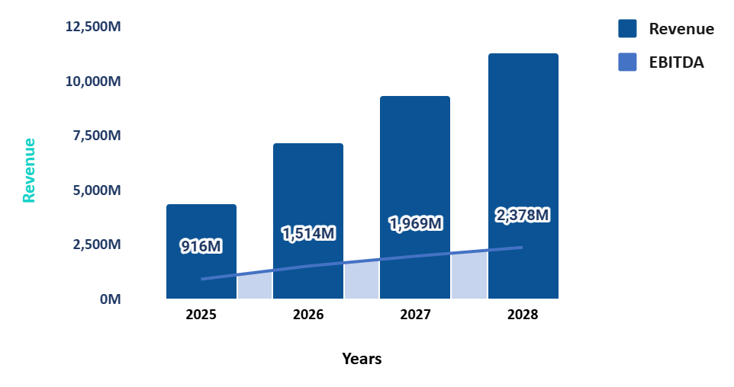
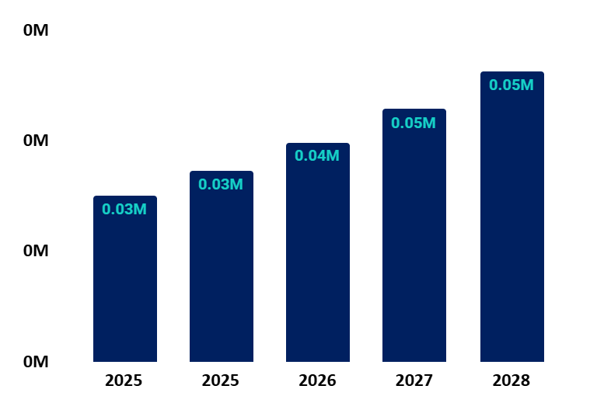
Financial
Revenue & EBITDA
Total Active Users

Slide 17

Our Team
Ese Anthony
CEO – Co-Founder

Slide 18
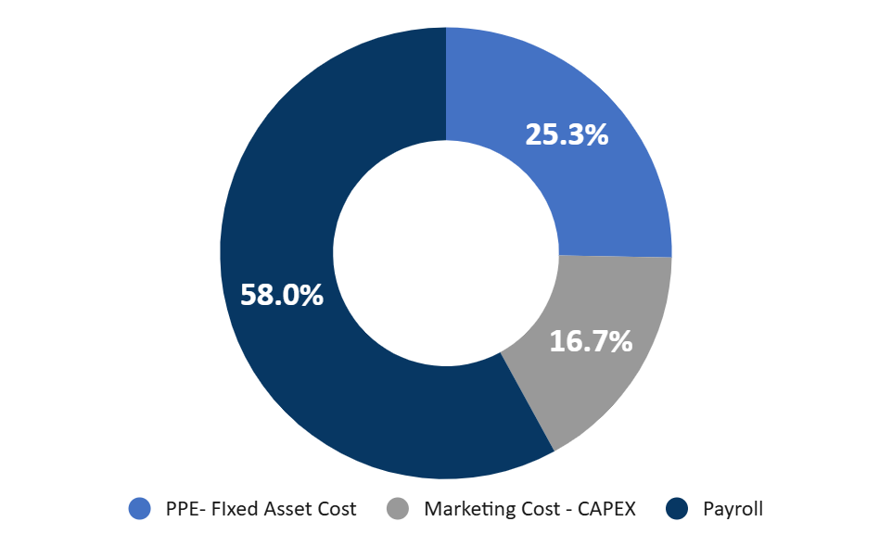
Our Ask
N21.8 Million
25% PPE
17% OPEX - Marketing
58% Payroll-Admin

Slide 19
Thank You
Website: www.trybongo.com
Official email: founders@trybongo.com
Tel No.: +234 8109992366
@bongoselekt

